Slide 1

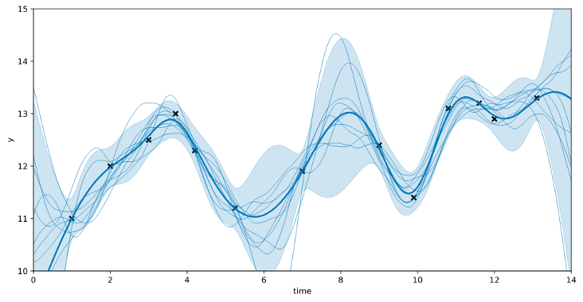
Maximum Likelihood Estimation in Gaussian Process Regression is Ill-Posed
Toni Karvonen and Chris J. Oates
Samuel Oliveira, Huey Sun, Anabel Yong
Machine Learning Seminar - Week 6
19th February 2024

Slide 2
Gaussian Processes
Define a distribution over functions
Fully defined by a prior mean function and a covariance kernel.
GP Learning: learn the hyperparameters of the mean function and covariance kernel.
Notes:
Notes

Slide 3
Hyper-Parameter Estimation
MLE Type 2 (Evidence/Marginal Likelihood).
Cross-Validation.
MAP Estimation.
Notes:
Notes

Slide 4
MLE Type-2
Most common hyper-parameter optimization process.
No additional degrees of freedom
Research Question: How do the ML estimates vary as a function of the input data?
Notes:
Notes

Slide 5
Paper Overview
Maximum Likelihood Estimation in Gaussian Process Regression is Ill-Posed
Theoretical conditions for MLE in GPs to be ill-posed.
Extension of these conditions to other methods:
CV
MAP
Use of regularisation to fix ill-posedness.
Notes:
Notes

Slide 6
Theoretical Settings
Noiseless data.
No observation noise, data represents truthful observations of an underlying function.
Non-asymptotic setting.
Finite number of datapoints.
Estimation of one single lengthscale parameter.
Notes:
Notes

Slide 7
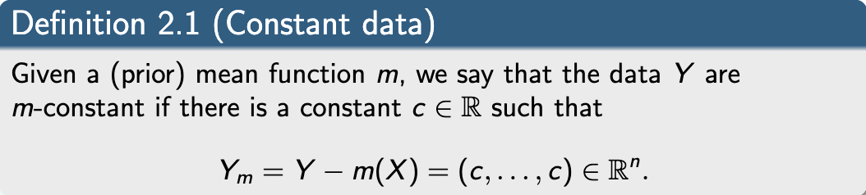
M-Constant Dataset
Notes:
Notes

Slide 8
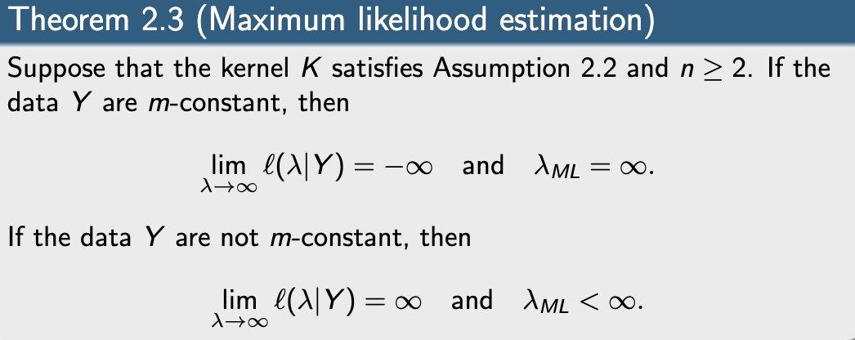
Maximum Likelihood Estimation
Notes:
Notes

Slide 9
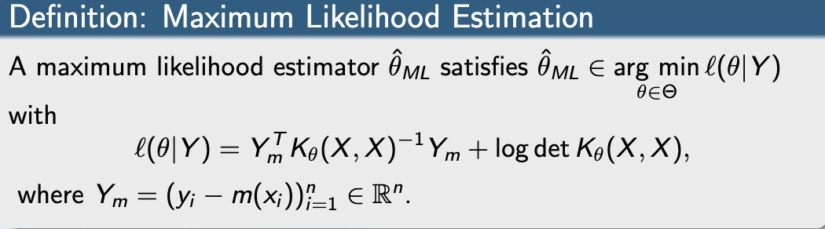
Trade-offs in the loss function
Notes:
Notes

Slide 10
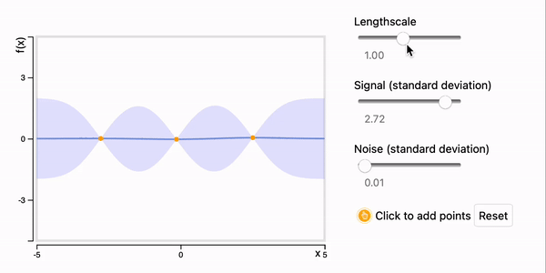
Intuition
Figure 1: Visualization of m-constant data as lengthscale varies, Deisenroth et al. [2]
Notes:
Notes

Slide 11

Trade-offs in the Log Likelihood Function
We can represent the kernel function as $Φ( \frac{x−y}{λ} )$.
Thus, our covariance function tends to $Φ( 0 )$as $λ→ ∞$ .
Notes:
Notes

Slide 12
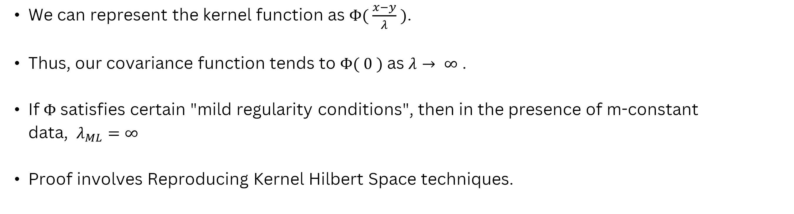
Trade-offs in the Log Likelihood Function
We can represent the kernel function as $Φ( \frac{x−y}{λ} )$.
Thus, our covariance function tends to $Φ( 0 )$as $λ→ ∞$ .
If $Φ$satisfies certain "mild regularity conditions", then in the presence of m-constant data, $λ_{ML}=∞$
Proof involves Reproducing Kernel Hilbert Space techniques.
Notes:
Notes

Slide 13
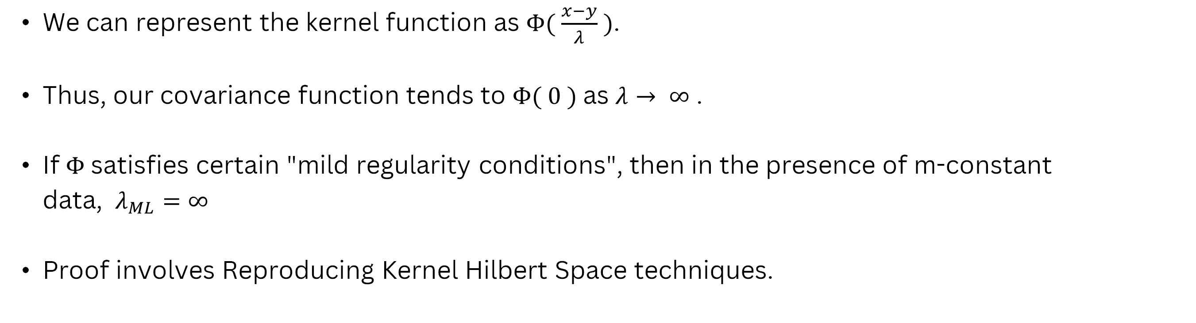
Trade-offs in the Log Likelihood Function
We can represent the kernel function as $Φ( \frac{x−y}{λ} )$.
Thus, our covariance function tends to $Φ( 0 )$as $λ→ ∞$ .
If $Φ$satisfies certain "mild regularity conditions", then in the presence of m-constant data, $λ_{ML}=∞$
Proof involves Reproducing Kernel Hilbert Space techniques.
Notes:
Notes

Slide 14
Formally defining ill-posedness
An inference or estimation problem is well-posed if:
a solution exists
the solution is unique
the solution depends on continuously on the data, i.e. the posterior is locally Lipschitz in the data with respect to the Hellinger distance
Notes:
Notes

Slide 15
MLE’s ill-posedness
As the lengthscale tends to infinity, the GP’s posterior covariance converges to 0.
No uncertainty estimation.
Small perturbations in the data result in drastic changes in the posterior.
Thus, MLE is ill-posed.
Notes:
Notes

Slide 16
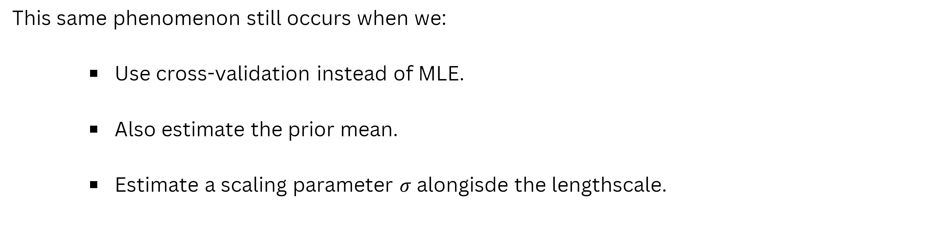
What does not help?
This same phenomenon still occurs when we:
Use cross-validation instead of MLE.
Also estimate the prior mean.
Estimate a scaling parameter $σ$ alongisde the lengthscale.
Notes:
Notes

Slide 17
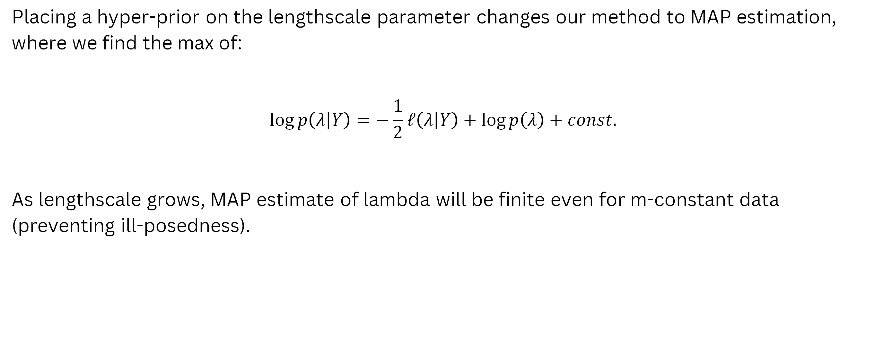
What does help?
Regularization via MAP
Placing a hyper-prior on the lengthscale parameter changes our method to MAP estimation, where we find the max of:
$$\log{p\left(λ | Y\right)=−\frac{1}{2}ℓ\left(λ | Y\right)+\log{p\left(λ\right)+const.}}$$
As lengthscale grows, MAP estimate of lambda will be finite even for m-constant data (preventing ill-posedness).
Notes:
Notes

Slide 18
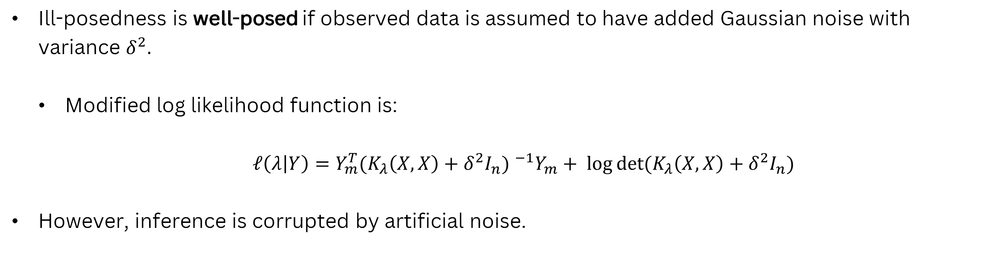
What does help?
Regularization via added observation noise
Ill-posedness is well-posed if observed data is assumed to have added Gaussian noise with variance $δ^{2}.$
Modified log likelihood function is:
$ℓ\left(λ | Y\right)=Y_{m}^{T}{(K_{λ}\left(X,X\right)+δ^{2}I_{n}) }^{−1}Y_{m}+ \log{\text{det}\text{(}K_{λ}\left(X,X\right)+δ^{2}I_{n}\text{)}}$
However, inference is corrupted by artificial noise.
Notes:
Notes

Slide 19
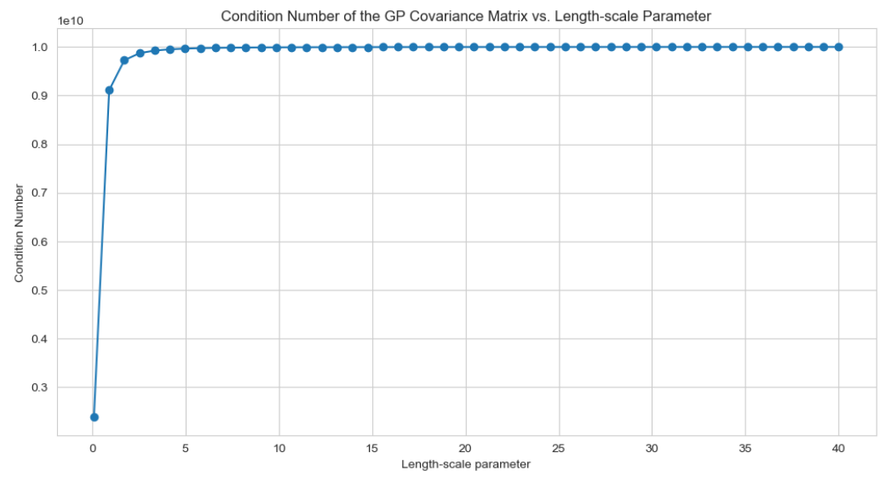
Pitfalls
However, even when we add observation noise, the covariance matrix can still be very close to singular if the lengthscale is too large.
Figure 2: Covariance matrix’s condition number as a function of lengthscale parameter.
Notes:
Notes

Slide 20


Practical Recommendations
How to use these results in practice?
Set an upper bound for the parameter estimate.
Likely to simply obtain that value, which might be somewhat arbitrary.
Check if data is m-constant before training the GP.
If so, warn the user that training will diverge.
Notes:
Notes

Slide 21
Future Work
Obtain theoretical results on the behaviour of MLE for “close” to m-constant datasets.
Study estimation of parameters for other types of kernels (e.g. non-stationary).
Notes:
Notes

Slide 22
References
[1] Karvonen T, Oates CJ. Maximum Likelihood Estimation in Gaussian Process Regression is Ill-Posed. 2023.
[2] Deisenroth M, Luo Y, van der Wilk M, A Practical Guide to Gaussian Processes, 2020
https://infallible-thompson-49de36.netlify.app/
[3] Johannes B, Minnen D, Singh S, Sung Oh Hwang, Johnston N. Variational image compression with a scale hyperprior.
[4] Introduction to Gaussian Process Regression https://juanitorduz.github.io/gaussian_process_reg/
Notes:
Notes

Slide 23
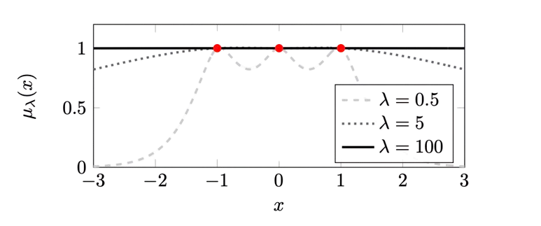
Appendix 1: Visualizing m-constant GP's
Figure A1: GP posterior mean across various lengthscales, for m-constant data. Karvonen et al. [1]
Notes:
Notes

Slide 24
Appendix 2: Generalizations and Extensions
Linear Information and General Kernels
Product Kernels and Multiple Lengthscales
Infinitely Smooth Kernels
Notes:
Notes

Slide 25
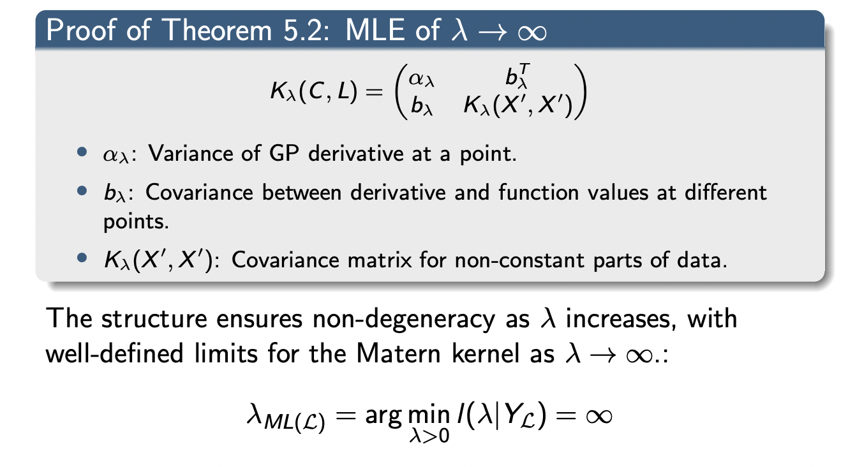
Appendix 2.1: Linear Information and General Kernels
Notes:
Notes

Slide 26
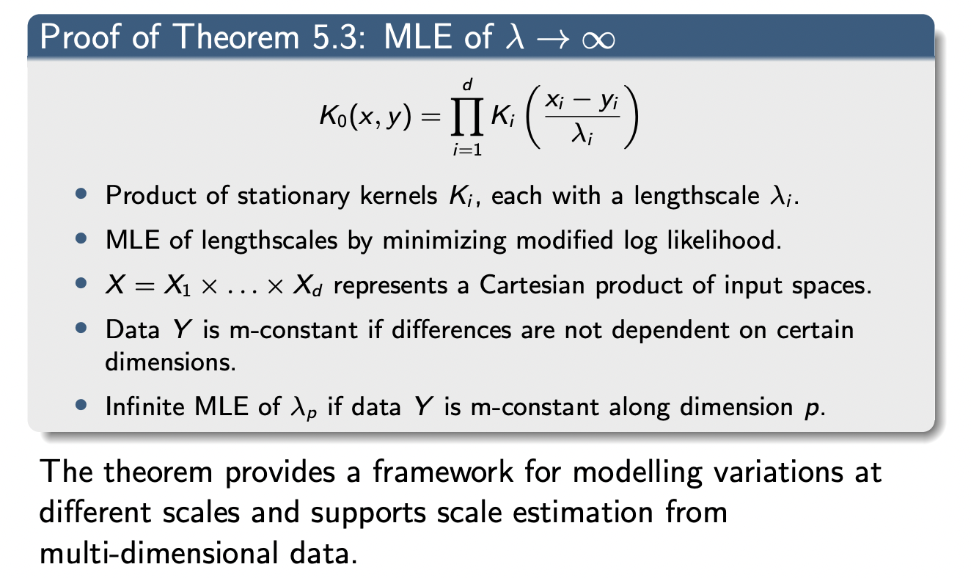
Appendix 2.2: Product Kernels and Multiple Lengthscales
Notes:
Notes

Slide 27
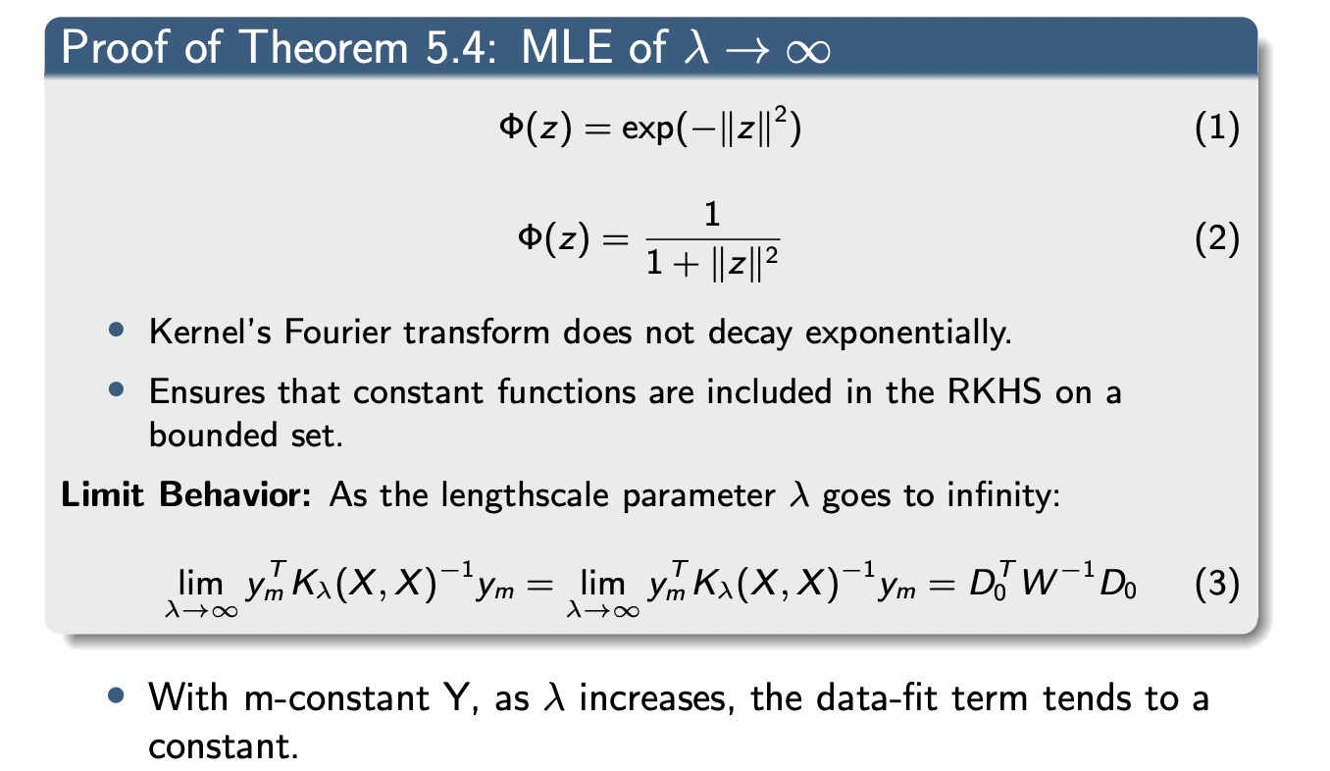
Appendix 2.3: Infinitely Smooth Kernels
Notes:
Notes

Slide 28
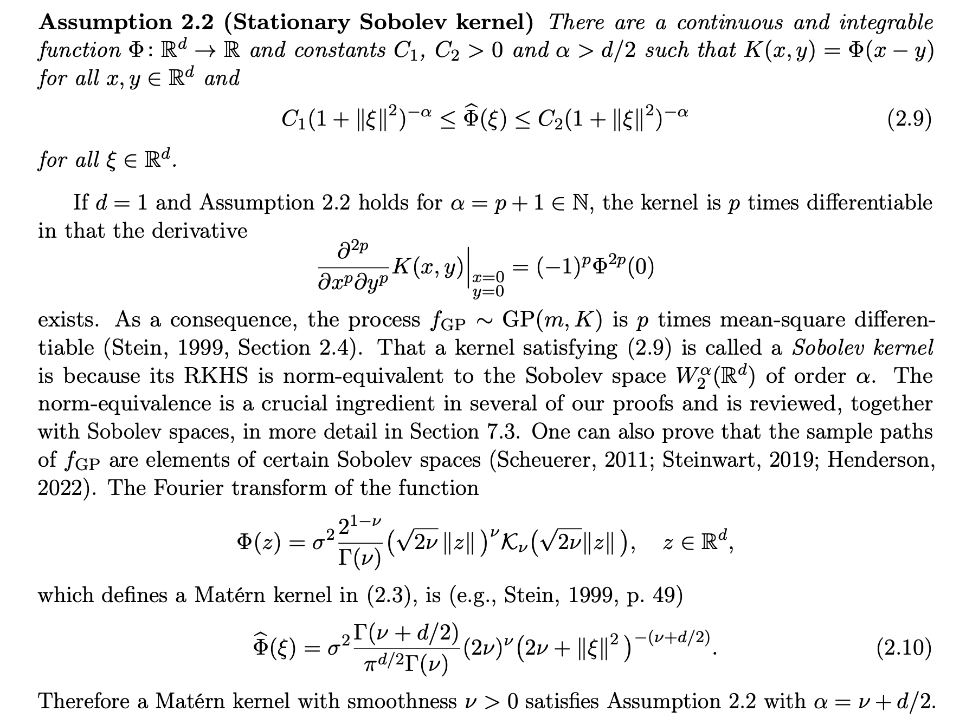
Appendix 4: What are said "mild regularity conditions"?
In short, we want our kernel Φ to have a polynomially decaying Fourier transform.
Also, our kernel must be stationary and positive definite
Notes:
Notes

Slide 29
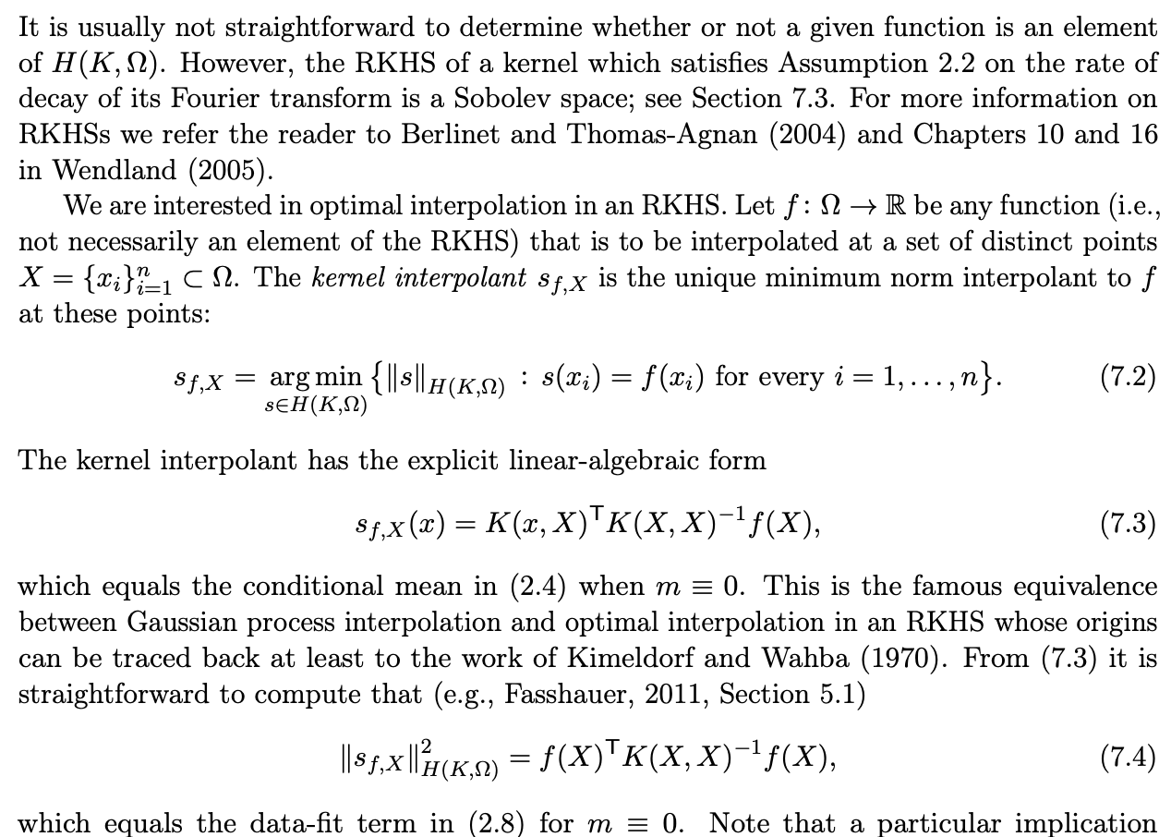
Appendix 4b: Why is this relevant?
We can use the equivalence between Gaussian process interpolation and optimal interpolation in an RKHS in our proofs
This allows us to bound the data fit term!
Notes:
Notes

Slide 30
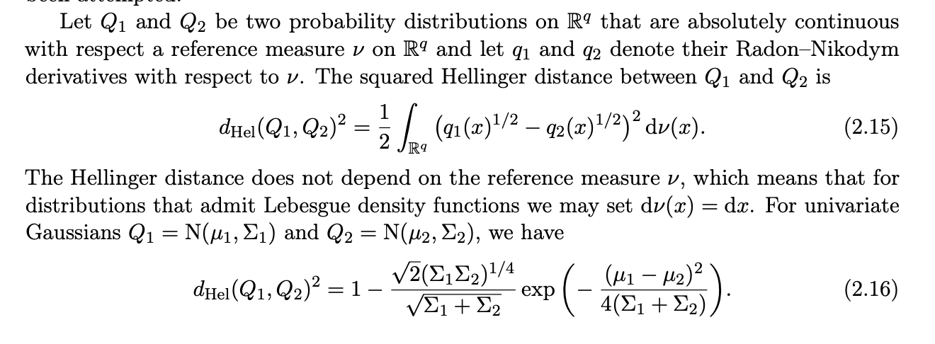
Appendix 5a: What was that Hellinger distance stuff?
Notes:
Notes

Slide 31
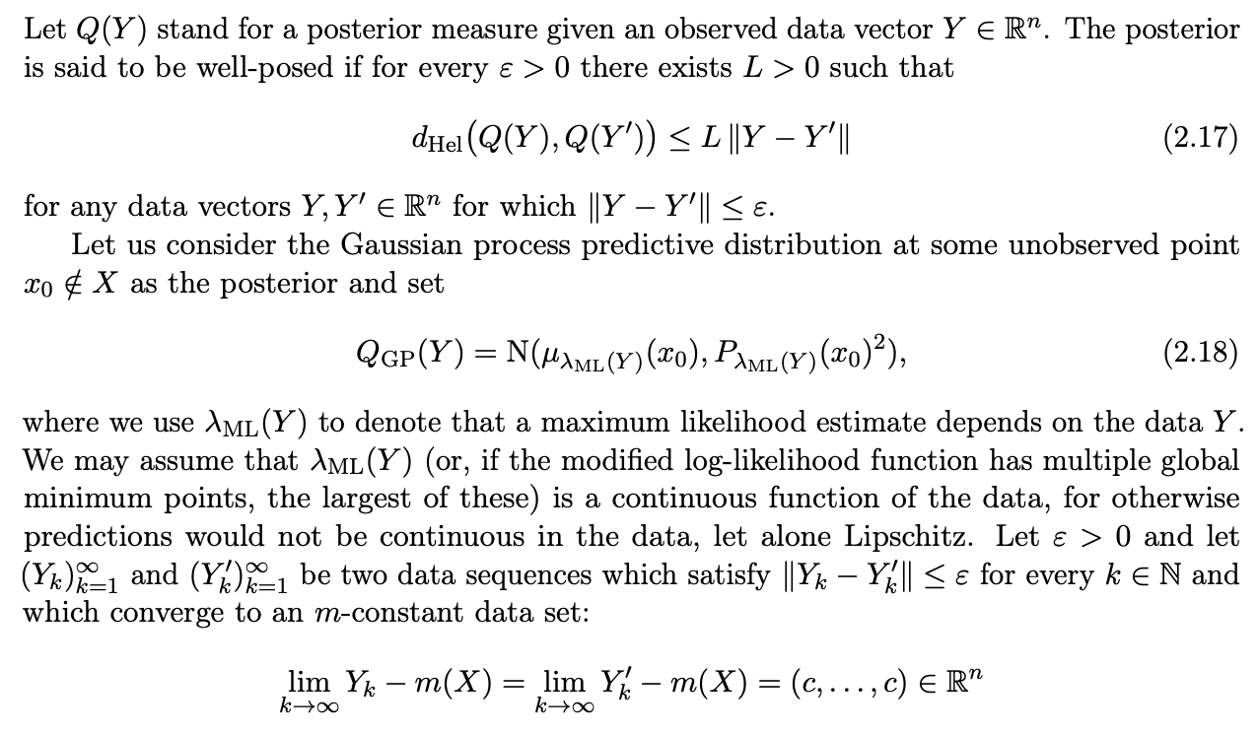
Appendix 5b: How does it relate to ill-posedness?
Definition of Lipschitz continuous
Define two sequences that converge to a m-constant data set
Notes:
Notes

Slide 32
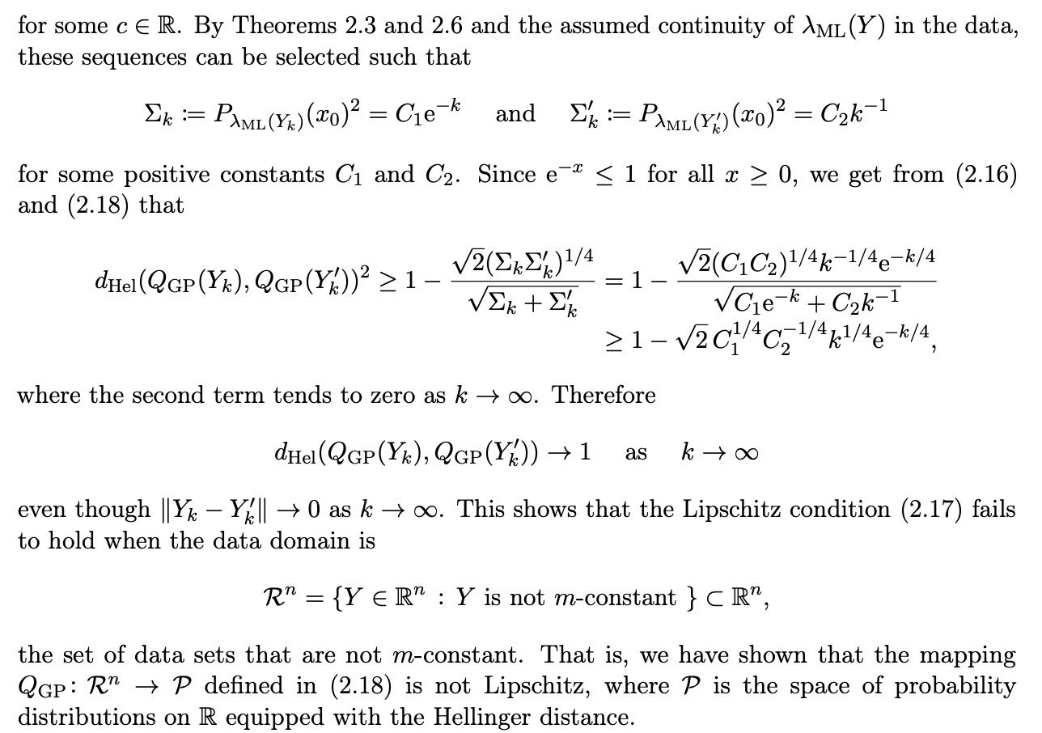
Appendix 5b: How does it relate to ill-posedness? (cont.)
Be tricky with selection of the sequences
This is a consequence of the covariance equaling 0, as any data that is not m-constant will have a Hellinger distance of 1
Notes:
Notes

